Slide 1


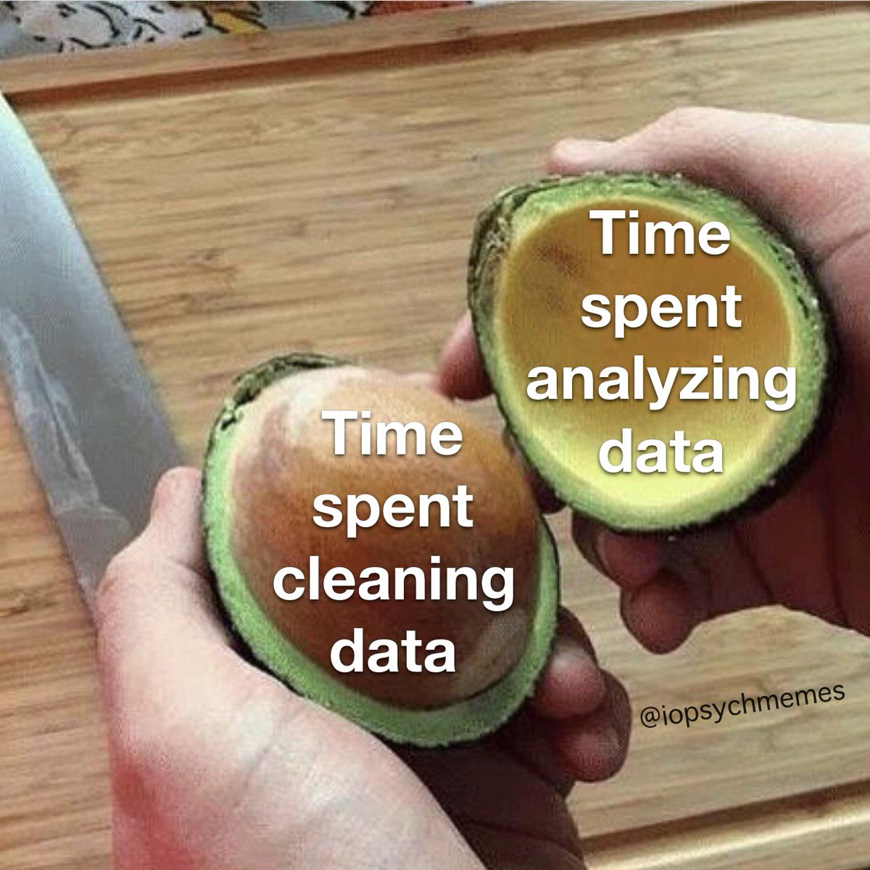
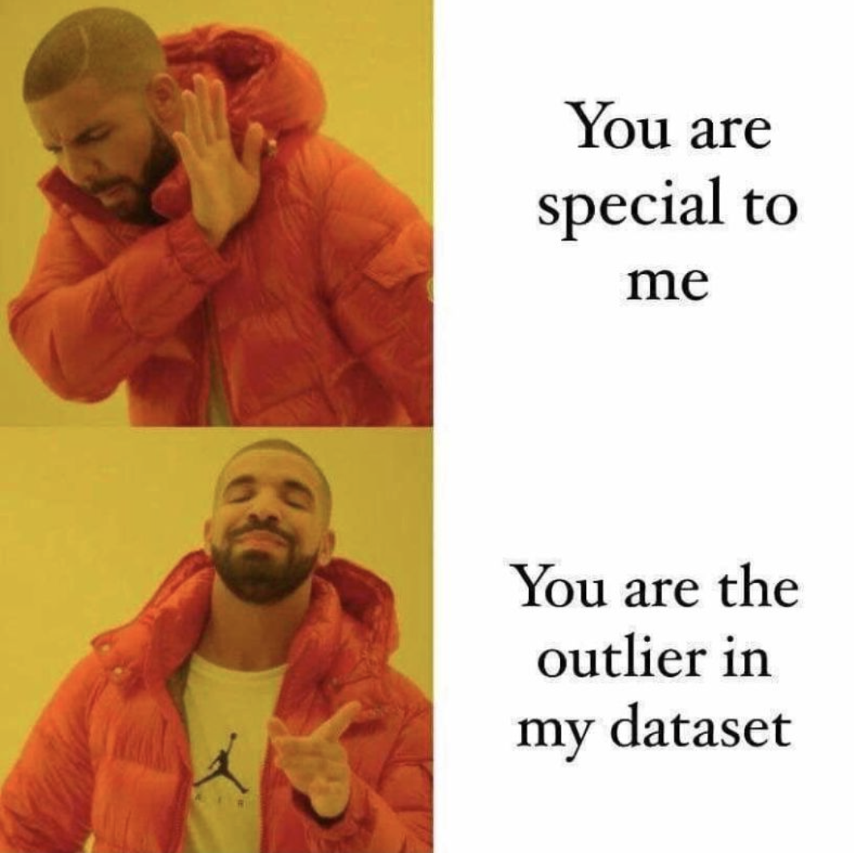

Data 100
Discussion #3
February 8th, 2023
Sign in here: https://tinyurl.com/data100-sp23-dis
Password: rahul3.14
Credit to Bella for these slides lol
Slides: https://tinyurl.com/rahul-slides
P.S. Add memes to Ed thread!!

Slide 2
Announcements 🎉
Homework #3 is due 2/9 at 11:59 pm
Exam prep sections are now running every Friday – keep an eye on Ed for the week-to-week details
Special linear algebra overview lecture on Zoom this Friday, 2:30-4 pm. I will probably be there to help answer questions 👀
Slides: https://tinyurl.com/rahul-slides

Slide 3
Regular Expressions 🧵
There are two building blocks to any regex pattern: literal characters and special characters.
Literal characters are literally the character they represent — alphanumeric (A-Z and 0-9) characters
The regex pattern
matches
the text “bears”
bears
Go bears!
Special characters make things more interesting…

Slide 4
More Regular Expressions 🐻
Or: |
r“go|bears” matches “go” or “bears”
Zero or more characters: <symbol>*
r“b*ear” matches “bdfkjnfksdnear”, “bear”, “ear”...
Does not match: “rahul”
One or more characters: <symbol>+
r“b+ear” matches “bear”, “bbear”...
Does not match: “ear”, “bcear”
Zero or one of the symbol before: <symbol>?
r“bears?” matches “bear”, “bears”
Sub-expression: ()
r“(go)*bears” matches “bears”, “gobears”, “gogobears”...

Slide 5
Even More Regular Expressions 🐻
Any character: .
r“bear.” matches “bears”, “beard”...
Character class: [ ]
r“bears[0-9]” matches “bears1”, “bears8”...
Character class negation: ^
r“[^a-z]ears” matches “Bears”, “1ears”...
Escape character (read the next character literally): \
r“bears\.” matches “bears.”
Match start/end of a string: start - ^ end - $
r“^bears$” matches “bears” but not “gobears!”
Built-in character classes:
\w - alphanumeric values
\d - numeric digits
\s - whitespace
[a-z] - lowercase letters
[A-Z] - uppercase letters
[0-9] - digits 0-9

Slide 6
EDA +
Data Cleaning

Slide 7
Variable Types 🧋
Quantitative continuous
Numerical variable that can take on any value
Ex: the volume of a cup of boba (300 mL, 300.5 mL, 300.55 mL…)
Quantitative discrete
Numerical variable that can only take on whole-number values
Ex: the number of pearls in a cup of boba (1, 2, 3…)
Qualitative ordinal
A set of categories that have some sense of ranking/order
Ex: a five-star review system for restaurants (5 = great, 1 = poor)
Qualitative nominal
A set of categories that aren’t specifically ordered
Ex: the names of boba stores in Berkeley (Raretea, Happy Lemon…)

Slide 8
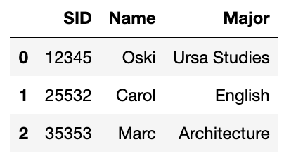
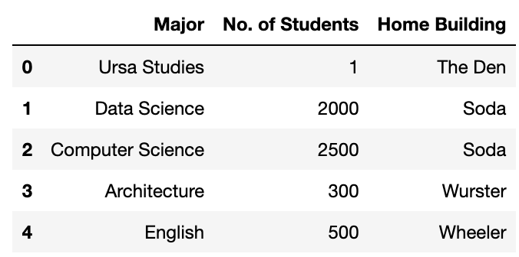
Primary and Foreign Keys 🔑
students
departments
A primary key is the smallest set of column(s) that uniquely identifies each row
students: “SID” departments: “Major”
A foreign key is 1+ column(s) that reference the primary key of another table
“Major” is a foreign key of students that references the primary key
of departments

Slide 9
The Big Picture

Slide 10
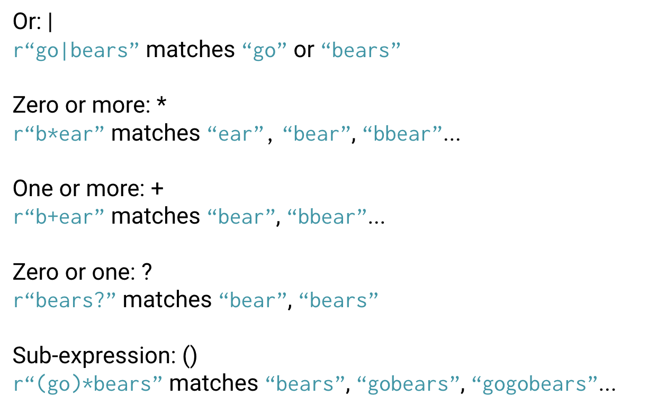
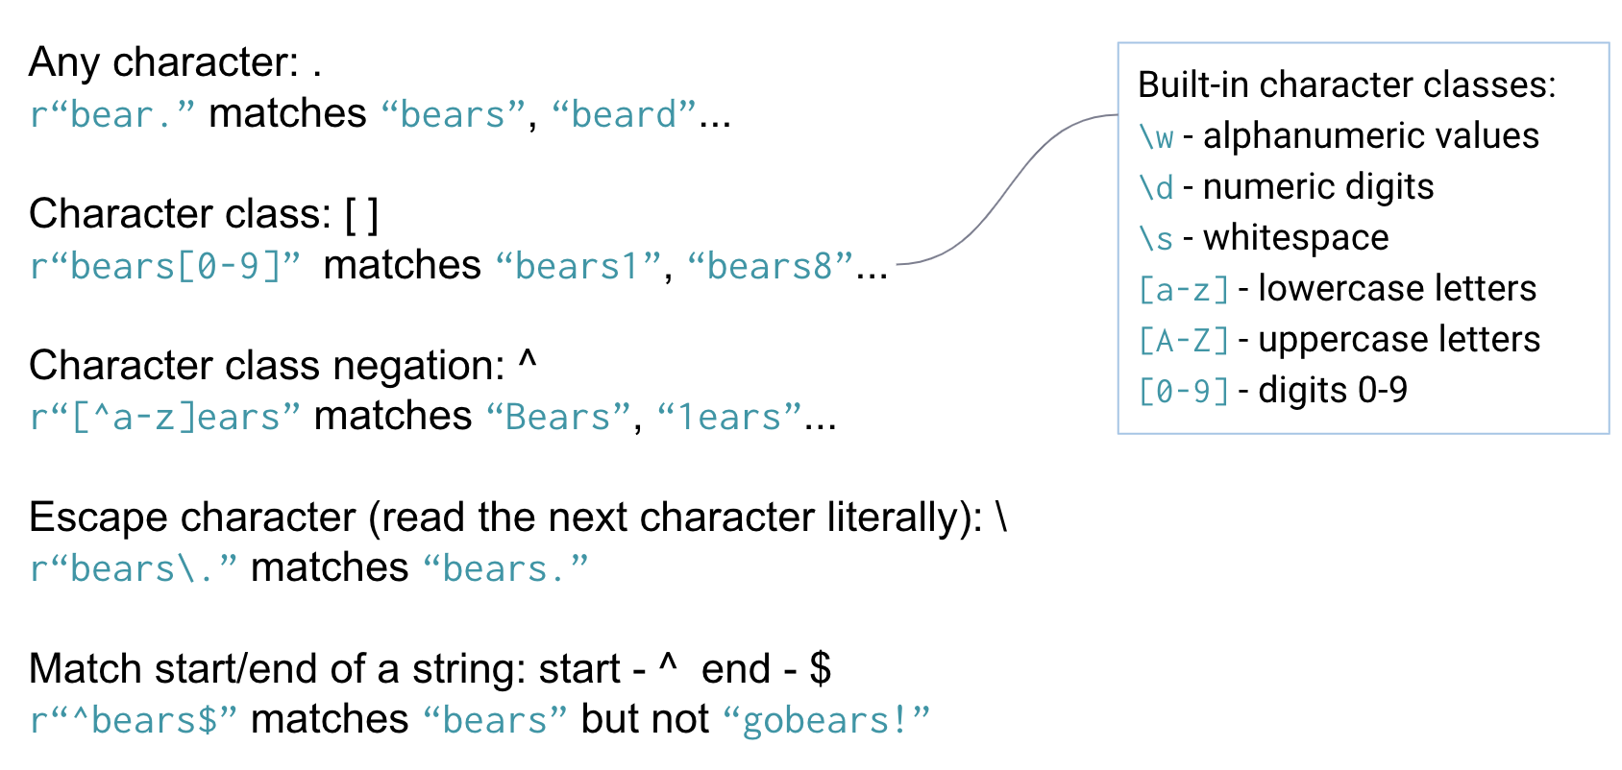
Primary Key
What is it? The minimal set of columns to unique identify each row in a table
Why do we care? Primary keys define the level of detail described by our dataset
Quantitative continuous
A numerical variable that can be measured with arbitrary precision (decimal places)
Quantitative discrete
A numerical variable with finite values (integer count data)
Variables
Qualitative ordinal
A set of categories with some sense of ranking
Qualitative nominal
A set of categories with no specific order
Regex

